Slide 1


Sales Forecast and Churn Prediction for the International Health Insurance Company
Course: Data Science Continuous Mar23
Jonathan Leipold | Christian Hirning | Rumiya Al-Meri

Slide 2
Problem description & Project objectives
Problem description:
Manual estimations of future sales amount
No existing Churn prediciton
Objectives:
Initially two main goals were defined:
Find the best model for forecasting / predicting the premium amount
Find out how premium adjustments impact the value of premium amount
Within the churn prediction sub-project another two goals were defined:
Identify main features that have an impact on customers’ termination behaviour
Find active contracts that are more likely to get terminated by the customer
Notes:
Initially two main goals were defined:
Find the best model for forecasting / predicting the premium amount
Find out how premium adjustments impact the value of premium amount
Within the churn prediction sub-project another two goals were defined:
Identify main features that have an impact on customers’ termination behaviour
Find active contracts that are more likely to get terminated by the customer

Slide 3
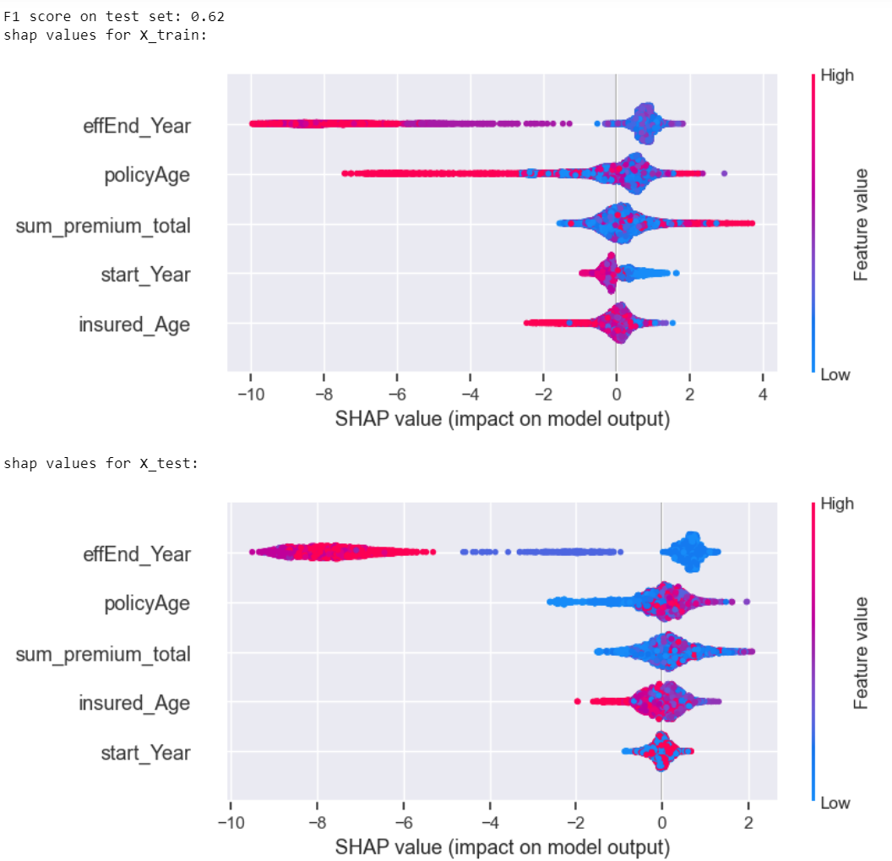
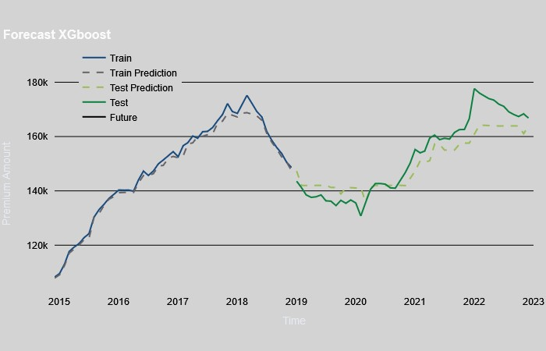
SubProjects
Sales Forecast
Churn Prediction
Time Series and Classification Models
Classification Models and SHAP
Notes:
3 SubProject created

Slide 4
Data sets
4 views were exported from the ERP-System SAP Business One
Some features were created by calculations in SQL.
SalesData-Example.csv:
premium_adjustments_example.csv:
about 230 000 transactions
adjustments of premium amounts
special characteristics of products like category, max. duration, etc.
all contracts after 01.01.2017.
incoming and outgoing cash flow for one main product
2014-2023 YTD
58 lines
BDAE_DataMining_Policies.csv:
each line - specific adjustment date, ZoneModel and product group
about 20 000 lines)
contract information, other variables calculated as sums, ratios etc. of the transaction lines used
BDAE_DataMining_Products.csv:
about 300 lines
Notes:
More about Data collection later by Jonathan

Slide 5
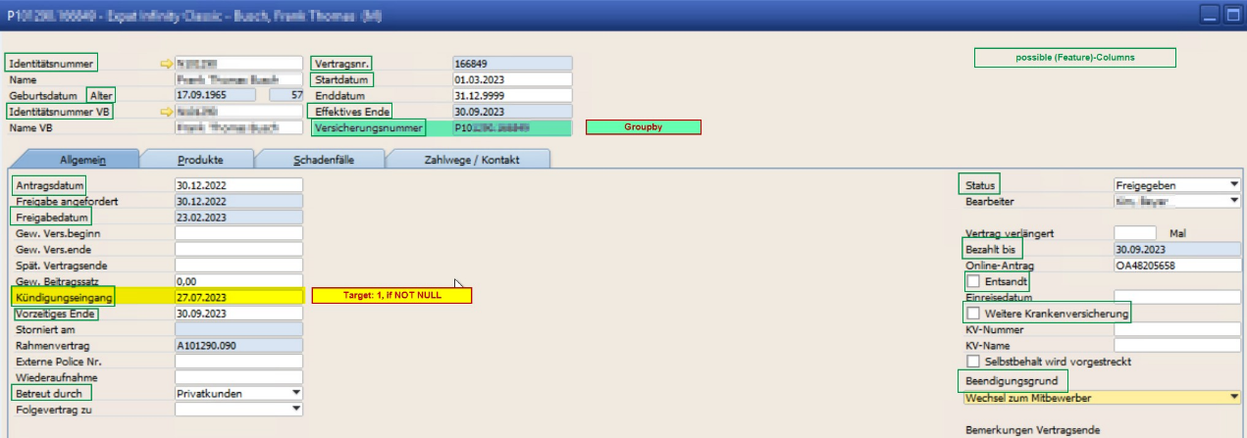
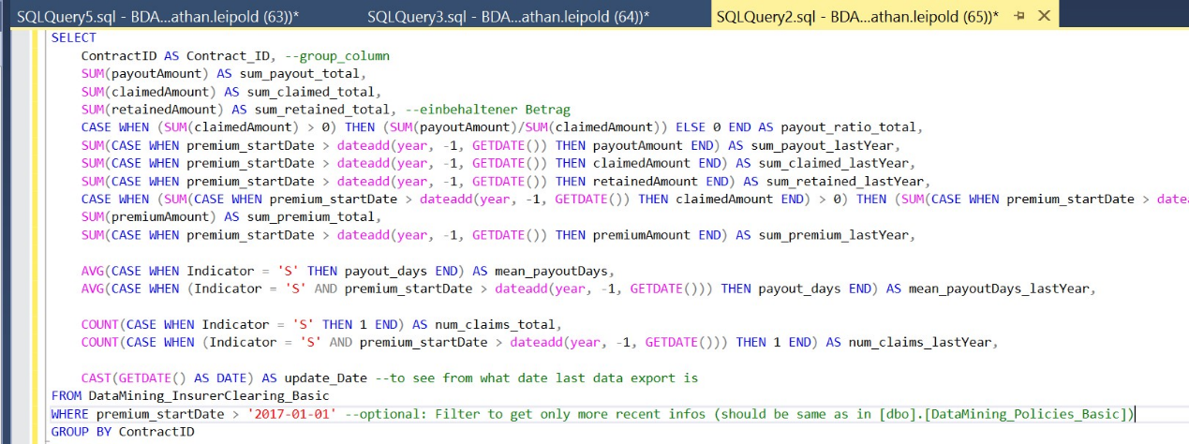
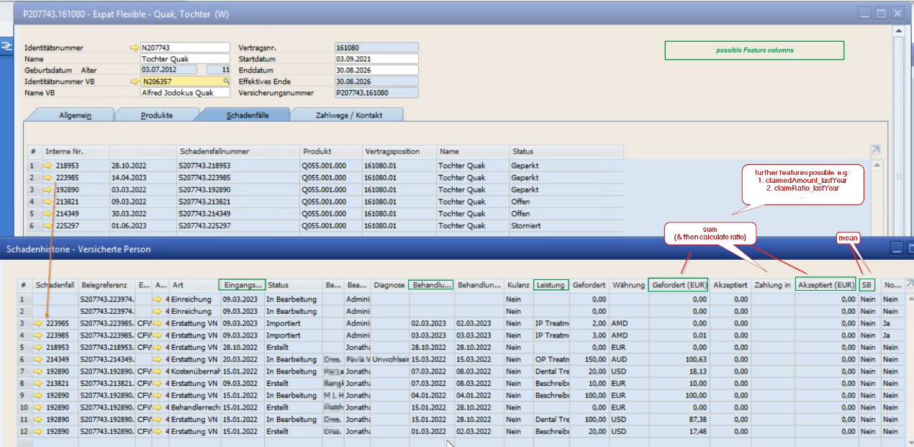
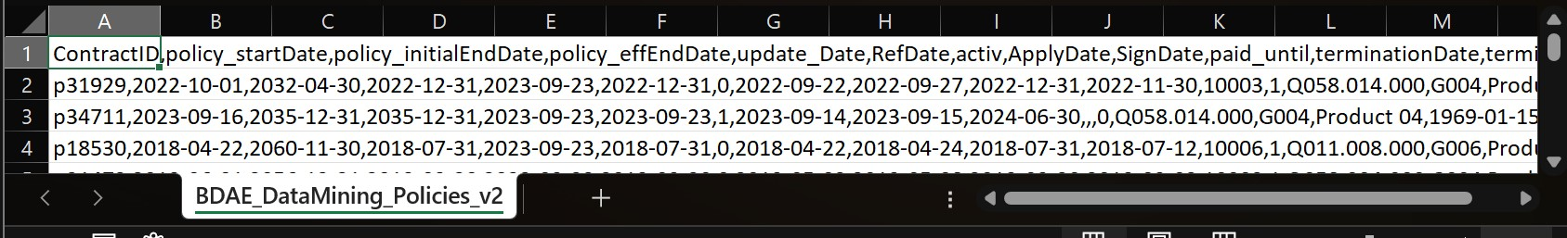
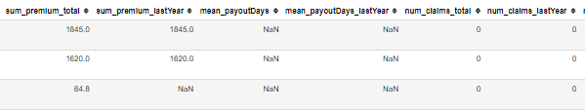
Data Collection
1. ERP System: Data Selection
2. SQL: processing & feature creation
3. Export to csv
4. Import in JupyterNotebook
Notes:
1. SAP: ContractData + Premiums-/Claims-Data
2. SQL: Sum & calculate measures forpremiums & claims

Slide 6
Sales Forecast
First Sub-Project

Slide 7
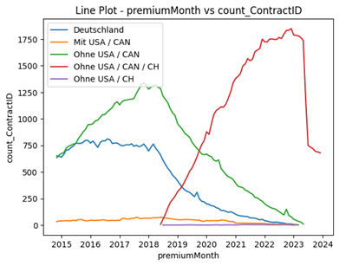
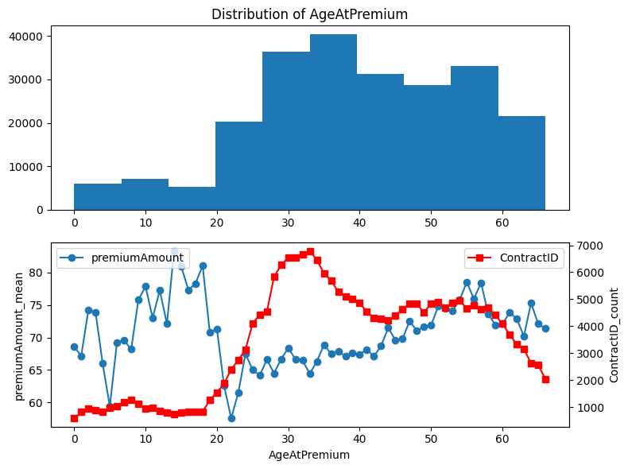
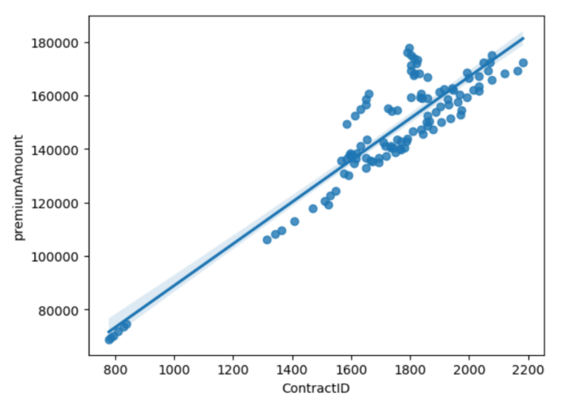
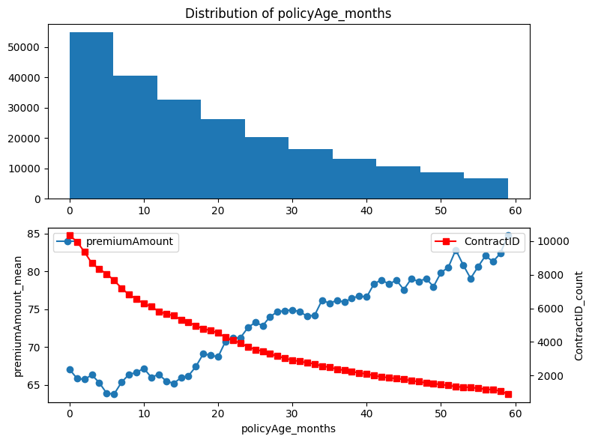
Data exploration
The replacement of old zone model with the new one explains the drop in 2018-2019
Strong correlation between premiumAmount and ContractID
There is less number of long-term contracts whereas Premium amount increases over time
No obvious correlation between Age at premium and premium amount, still the premium amount increases with the age after 25 years.
Notes:
ContractID = Number of Contracts

Slide 8
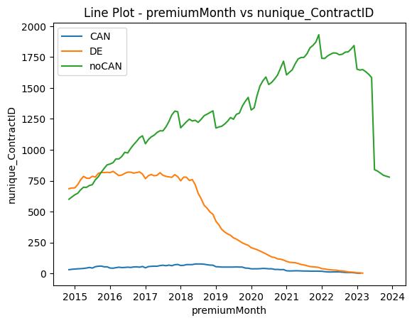
Data preparation
A new variable Zone_United was created to include this zone conversion.
Optional parameters for ZoneModel are included in the preprocessing function.
Notes:
Because to this change, the old zone model and the new zone model were considered and analysed separately. This presented a greater challenge. After analysing the data, no relevant features could be generated to predict the future development of the premium amount. This limited our ability to select additional features for modelling at a later stage. Despite the limitations, we analysed the premium amount using time series models and classification models.

Slide 9
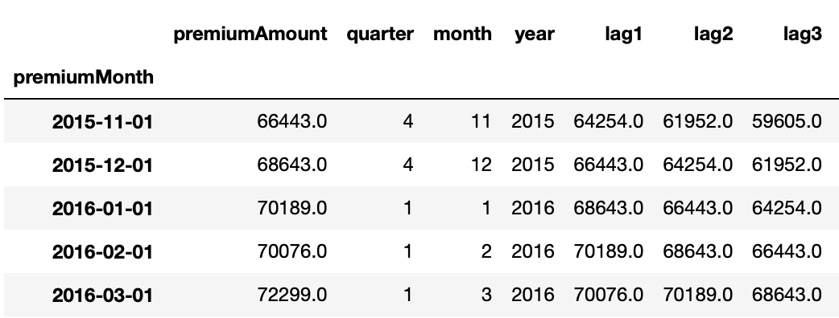
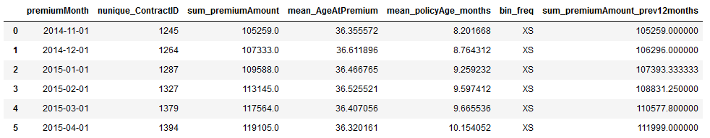
Data
Target Variable:
Premium Amount grouped by Months from 2014 – 2023 (shape n=97)
Features:
Time Series:
Lag-Features
Features Month, Year and Quarter
Classification:
mean of Age atPremium and policyAge_months, and the rolling sum of premium amount over the last 12 months.

Slide 10
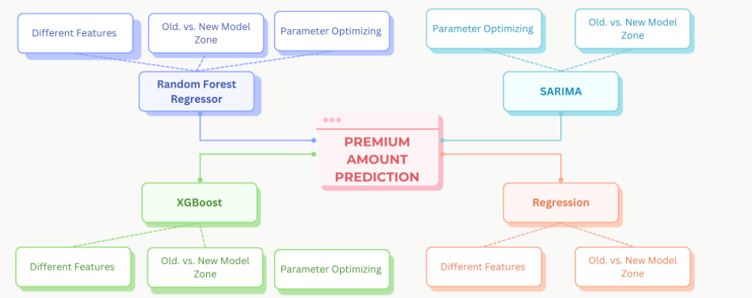
Models overview
Classification
Notes:
Because to this change, the old zone model and the new zone model were considered and analysed separately. This presented a greater challenge. After analysing the data, no relevant features could be generated to predict the future development of the premium amount. This limited our ability to select additional features for modelling at a later stage. Despite the limitations, we analysed the premium amount using time series models and classification models.

Slide 11
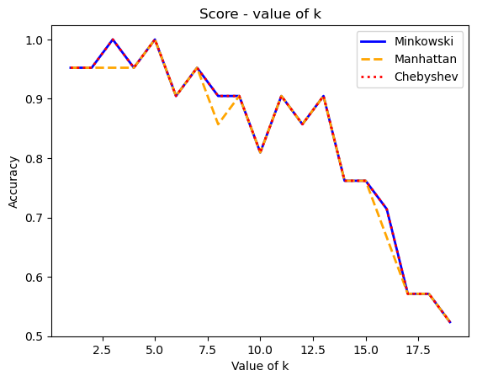
Models analysis & Critical view and perspectives
Classification: ​
KNN model performs better than SVM​
The best metric is Manhattan with the k=5​
Model / Metric | Accuracy
KNN / Chebyshev metric | 0.9523809523809523
KNN / Manhattan metric | 1.0
KNN / Minkowski metric | 0.9523809523809523
SVM | 0.9523809523809523
Classification approach is limited to a small number of features and the application in the business context where the sales forecast has to be precise and not a range or class. Moreover, the model has to be adapted over time as all future forecasts will be classified as an L-class, if the business is growing. ​
Notes:
TimeSeries --> Neu gemacht durch Christian → zusammen
Because to this change, the old zone model and the new zone model were considered and analysed separately. This presented a greater challenge. After analysing the data, no relevant features could be generated to predict the future development of the premium amount. This limited our ability to select additional features for modelling at a later stage. Despite the limitations, we analysed the premium amount using time series models and classification models.

Slide 12
Models analysis & Critical view and perspectives
Time Series: ​
Models: SARIMA, XGBoost, Multiple Linear Regression and Random Forest Regressor
R^2 and RMSE as Metrics
Consideration of the residues
GridSearch andTime Series Split
Limited by:
Small Amount of Data
Small Amount of Features (only Lag Features and Time Features like Month, Year, Quarter)
Different Zone Models
significantly different results depending on the time of the train test split
--> Demo in Streamlit
Notes:
TimeSeries --> Neu gemacht durch Christian → zusammen
Because to this change, the old zone model and the new zone model were considered and analysed separately. This presented a greater challenge. After analysing the data, no relevant features could be generated to predict the future development of the premium amount. This limited our ability to select additional features for modelling at a later stage. Despite the limitations, we analysed the premium amount using time series models and classification models.

Slide 13
Churn Prediction
Second Sub-Project

Slide 14
Data Description – Columns
Column | Datatype | Description
ContractID | string | pseudonymised unique ContractID (index / primary Key)
policy_startDate | date | start Date of contract (Filtered to >= 01.01.2017)
policy_initialEndDate | date | initial end Date at beginning of contract
policy_effEndDate | date | effective end Date of contract (due to earlier cancellation/…)
update_Date | date | date of last data extraction from SQL database
activ | boolean | if contract is still activ or already ended
ApplyDate | date | date of contact application by the customer
SignDate | date | date of contract signing by the customer
paid_until | date | date until premium is paid for this contract
terminationDate | date | date of contract termination by the customer
terminationReason | string / categorical | reason for contract termination
terminated | boolean | if contract got terminated by the customer (target variable)
product_code | string | code of insurance product
MainProductCode | string | code of main insurance product group
MainProductName | string | name of main insurance product group (pseudonymised)
insured_birthDate | date | birthday of insured person
insured_Gender | string | gender of insured person
insured_nationality | string | nationality of insured person
holder_country | string | country of contract holder
Expatriate | boolean | if insured person is expatriate
additional_insurance | boolean | if insured person has an additional insurance
Column | Datatype | Description
RefDate | date | reference date to compare last year of active (-> update_Date) and ended contracts (-> effEndDate)
num_claims_total | integer | total number of claims (invoices) handed in by the customer
sum_claimed_total | float | total amount of money claimed by the customer
sum_payout_total | float | total amount of money paid out to the customer
sum_retained_total | float | part of claimed money that did not get paid out
payout_ratio_total | float | total ratio of paid out vs. claimed money (payout/claimed)
mean_payoutDays | integer | mean waiting time in days between claim and payout of money
num_claims_lastYear | integer | same as above, but for last year before update_Date
sum_claimed_lastYear | float
sum_payout_lastYear | float
sum_retained_lastYear | float
payout_ratio_lastYear | float
sum_premium_total | float
sum_premium_lastYear | float
mean_payoutDays_lastYear | integer
num_claims_lastActivYear | integer | same as above, but for last year before RefDate (activ contracts --> last year / ended contracts --> last year before effEnd)
mean_payoutDays_lastActivYear | integer
sum_payout_lastActivYear | float
sum_claimed_lastActivYear | float
sum_retained_lastActivYear | float
sum_premium_lastActivYear | float
Notes:
Important columns:
Terminated
terminationReasons
Policy_start- & effEndDate
Sums of premium-, claim- & payout
+ Product information in separate df (less important because no big impact in modelling)

Slide 15
Problem Description
 |  | PREDICTED
 |  | Contract Terminated (1) | Contract Non-terminated (0)
TRUE |  | TRUE POSITIVE (TP) | FALSE NEGATIVE (FN)
 | Contract Terminated (1) | Model correctly predicts that the contract is terminated by the customer. | The model predicts that the contract is still active or has ended naturally but it is terminated.
 |  | FALSE POSITIVE (FP) | TRUE NEGATIVE (TN)
 | Contract Non-terminated (0) | The model predicts that the contract has been cancelled, but it is still active or has ended naturally. | The model correctly predicts that the contract is still active or has ended naturally.
Confusion Matrix
Notes:
Focus on big TP & small FP (False Negative) error → try to detect as many terminated contracts → keep track on precision too → F1 Score
→ Mainly focus on score of test set, containing more recent contracts

Slide 16
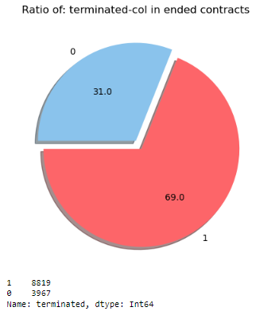
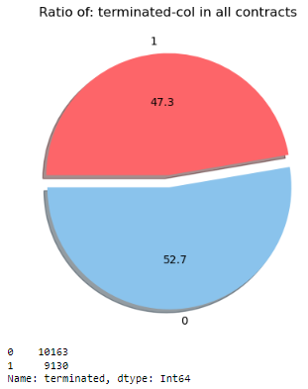
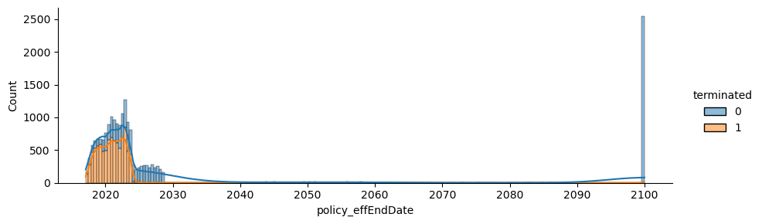
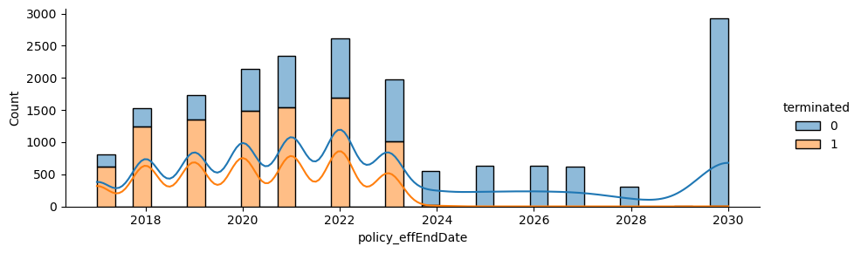
Data Exploration - Target & effEnd
Notes:
Termination rate goes → 0 for active contracts (effEndDate > now)
effEndDate can be cuted in preprocessing function
More specific look on termination with terminationReasons

Slide 17
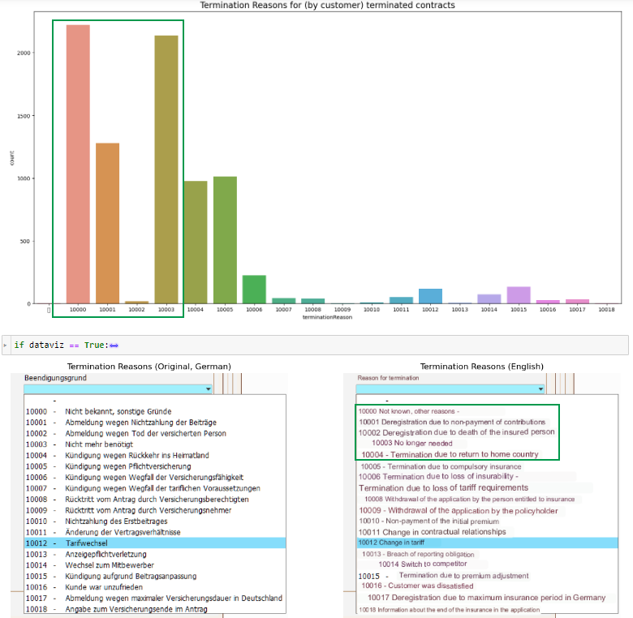

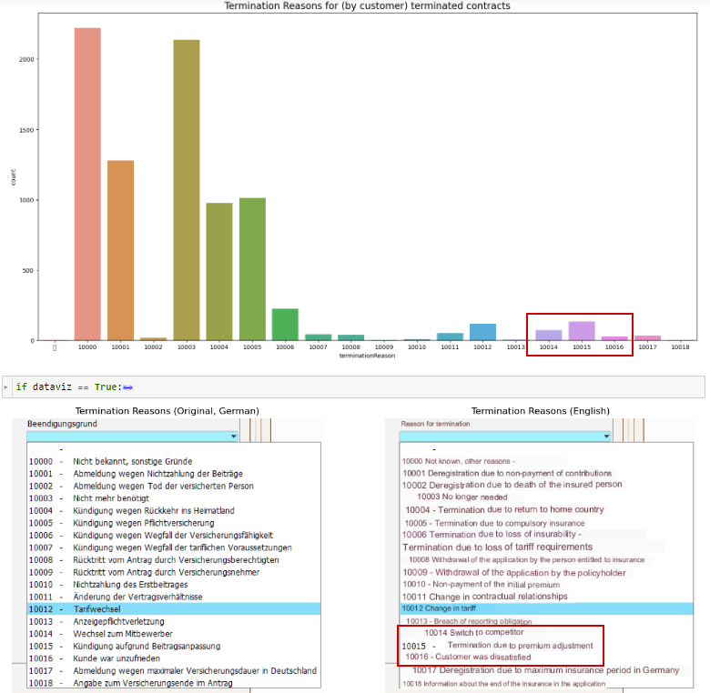
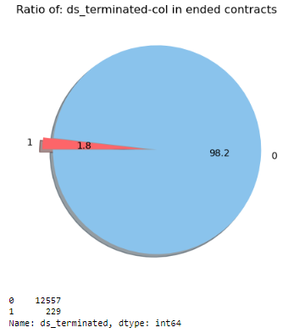
Data Exploration – Alternative target
Notes:
Looking at reasons of termination:
Mostly unspecific: Not know, No longer needed, Non-Payment (Cancelled by company by end of next month → next month not paid → terminated)
Looking only at reasons that show dissatisfaction → imbalanced data
→ Results were not good → got slightly better by resampling → Not showing now due to lack of time

Slide 18
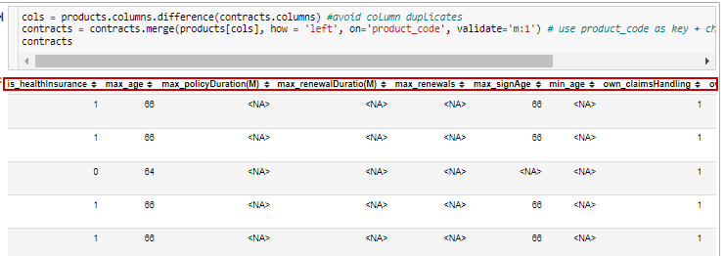
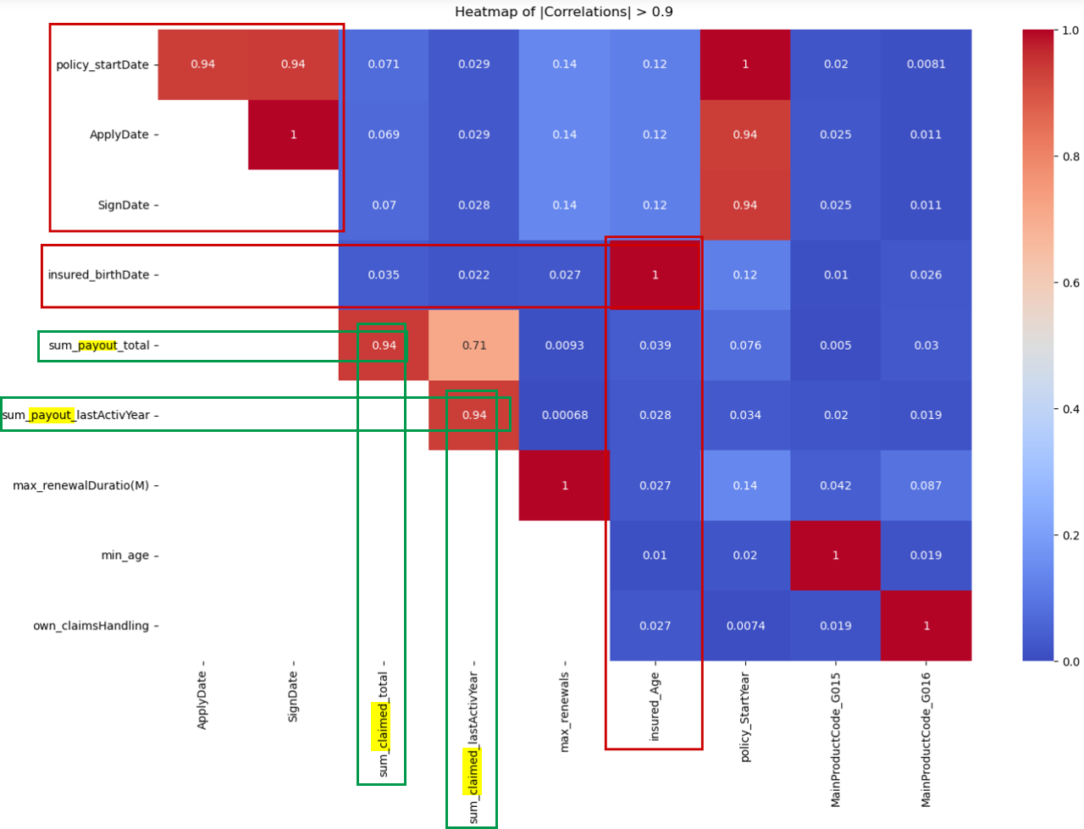
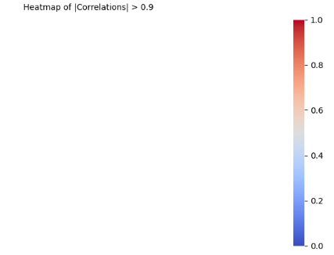
Data Preparation
Cut effectiveEndDate
Add product informations
Create claims ratios
Notes:
Claims ratios → Reduce high correlated features (claimed Amount + payout amount)
+ create time difference of dates around startDate (applyDate, signDate)
+ drop irrelevant / reduntant columns (e.g. retained amount)

Slide 19
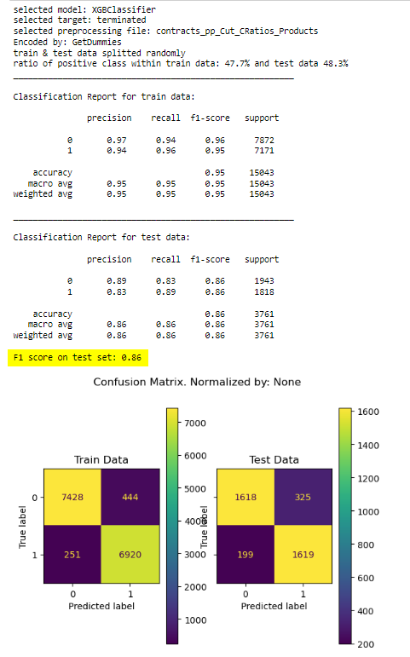
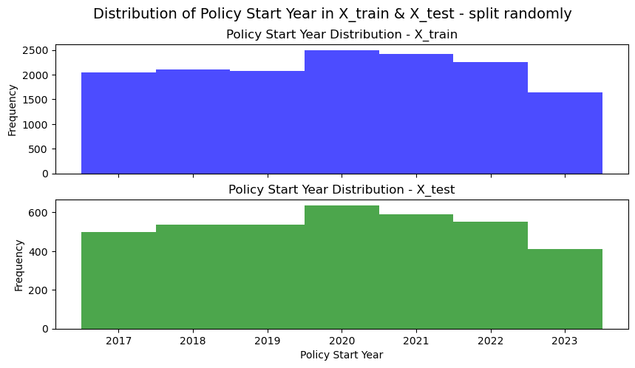
Modelling – Random Test data
Notes:
Good score on train- & test-data because: large difference between effEnd dates in both datasets
→ ended contracts could be detected as potentially terminated easily

Slide 20
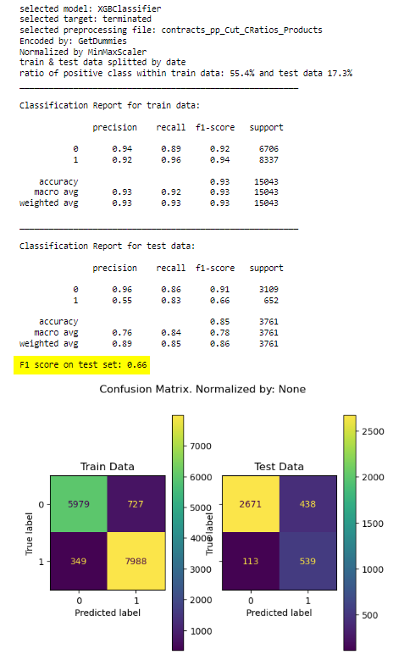
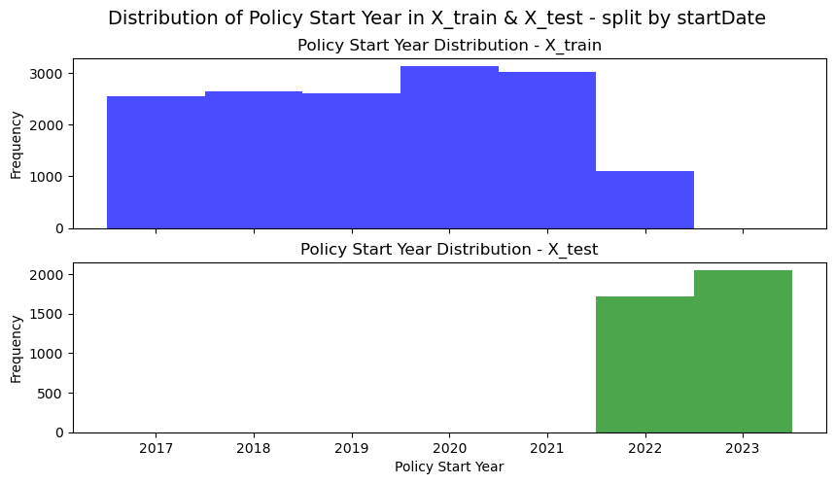
Modelling – Time-related Test data
Notes:
Use newer contracts for test data → eff EndDate is more similar (more active contacts)
→ harder to detect terminated contracts within active contracts

Slide 21
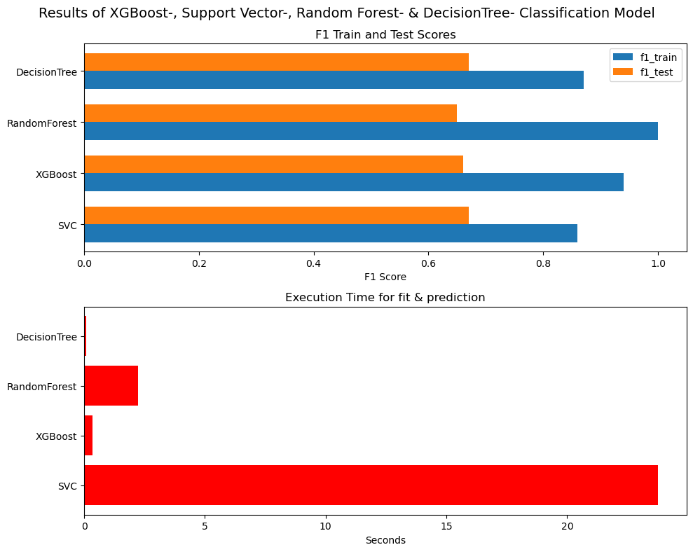
Modelling – Model comparison
Notes:
Similar results on test data (most recent contracts)
XGB & DT fastest & XGB works best with SHAP

Slide 22
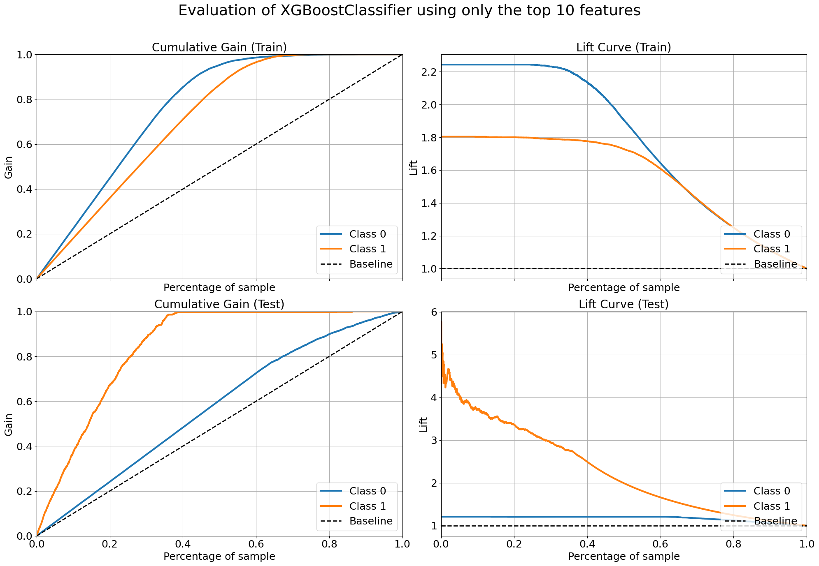
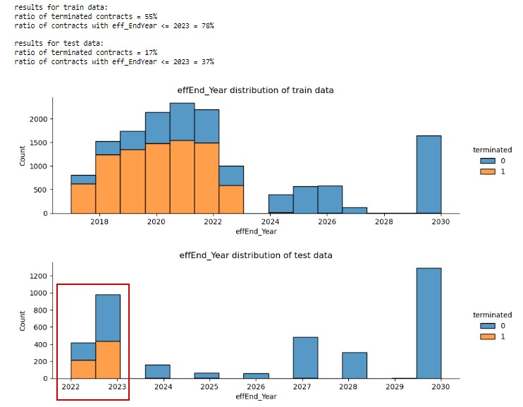
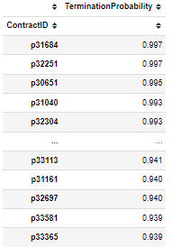
Modelling – Termination Probabilities
Notes:
Left: CumGain very good on Class 1 in TestData
Right: Reason = 37% of earliest effEnd includes all 17% terminated contracts --> If I select only by effEnd_Year:
I detect all terminated contracts fast (yellow) → BUT high FP rate as well (remaining 20%)

Slide 23
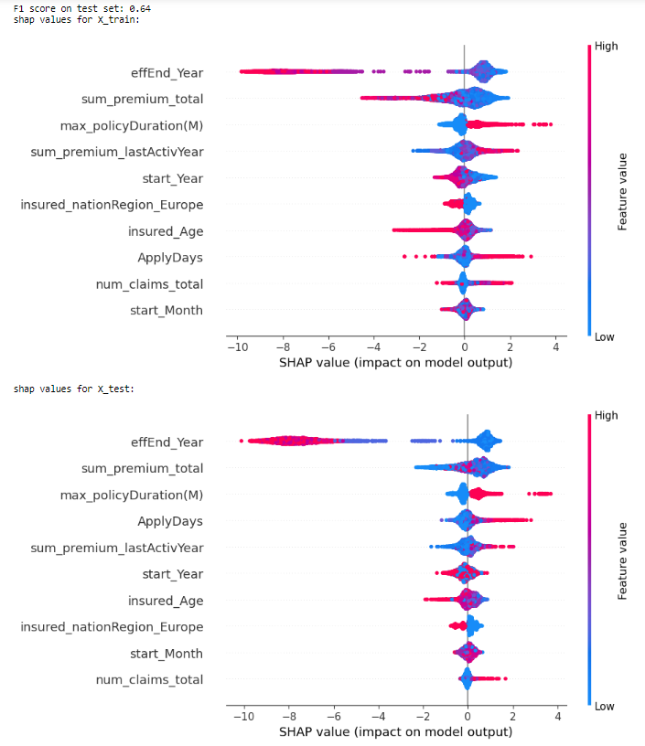
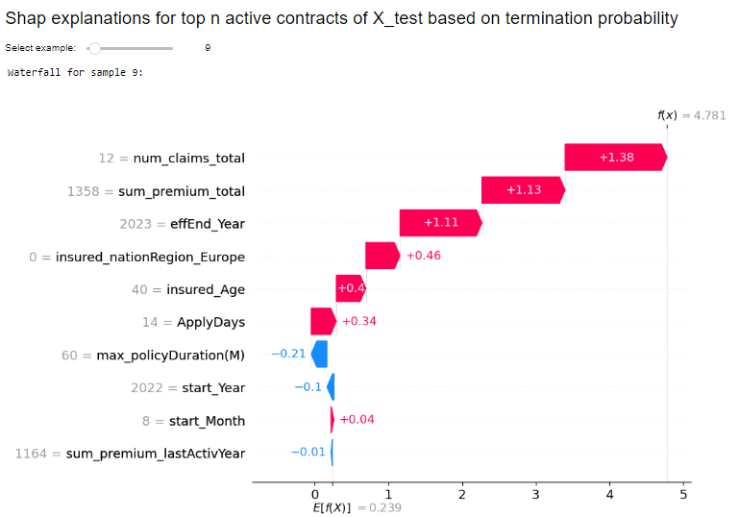
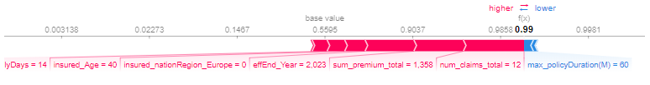
Modelling - SHAP Interpretations
→ Streamlit Demo
Notes:
For better overview only top 10 features taken
Left: Globally main features → effEnd dominant (low effEnd → terminated)
(- max_policyDuration → if infinit: set to highest policy age in df (81) → infinit contracts get terminated more often → positive impact)
Right: individual example of ACTIV contracts with highest proba being predicted as “terminated”:
In example: effEnd_Year = 2023 → could be ended already → additionally high number of claims

Slide 24
Conclusions
Results
Challenges
Sales Forecast:
Time series: Old Model Zone ML like XGBoost or Random Forest Regressor are suitable. For New Model Zone only Mulitple Linear Regression is suitable.
Classification: KNN-model with Manhattan metric shows the best results; still the model cannot be applied in the business context.
Churn Prediction:
Solid results, XGBClassifier most suitable for interpretation
Too much focus on effective end
Limited business relevant success
project management
real world data
preprocessing & interpretation
human made decisions
Notes:
As last side in streamlit

Slide 25
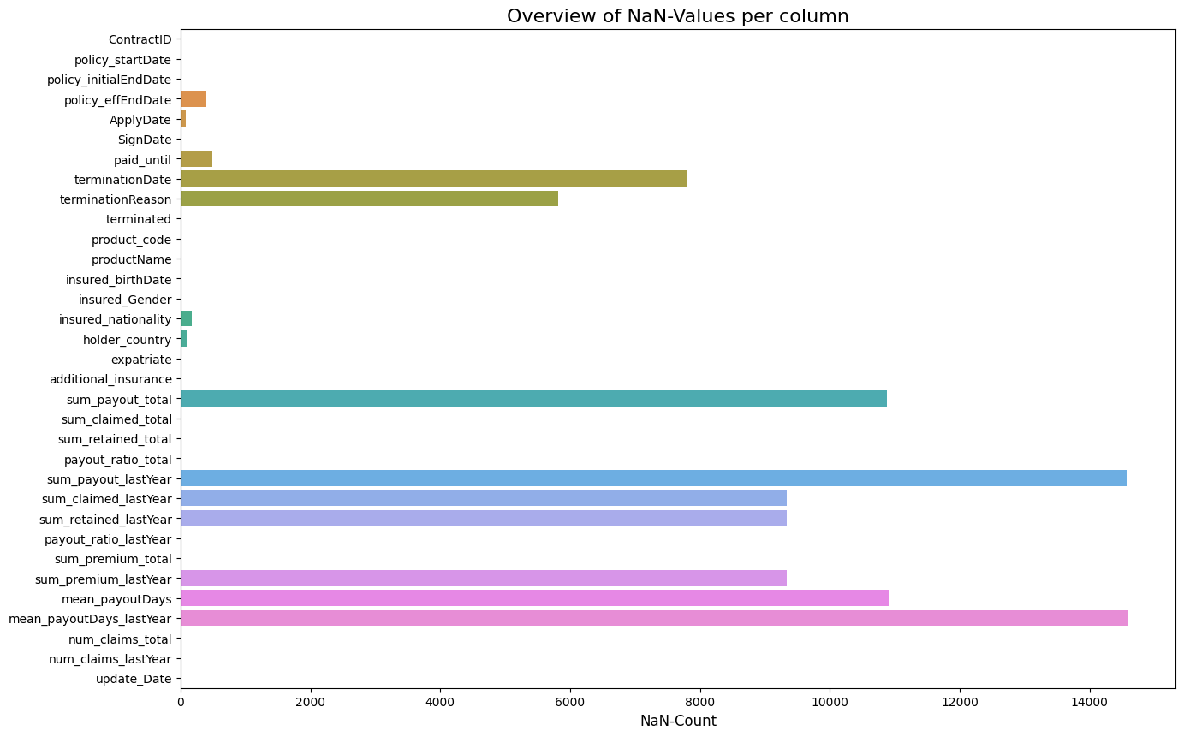
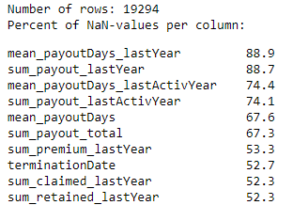
Churn Prediction – Challenge missing values
Notes:
Took a lot of time to explain & prepare all columns for modelling.
Besides missing values:
a lot of outliers
highly correlated columns
(not necessary → HIDE)

Slide 26
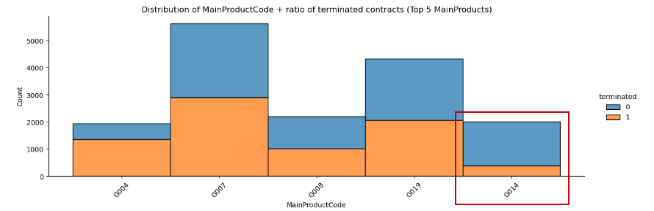
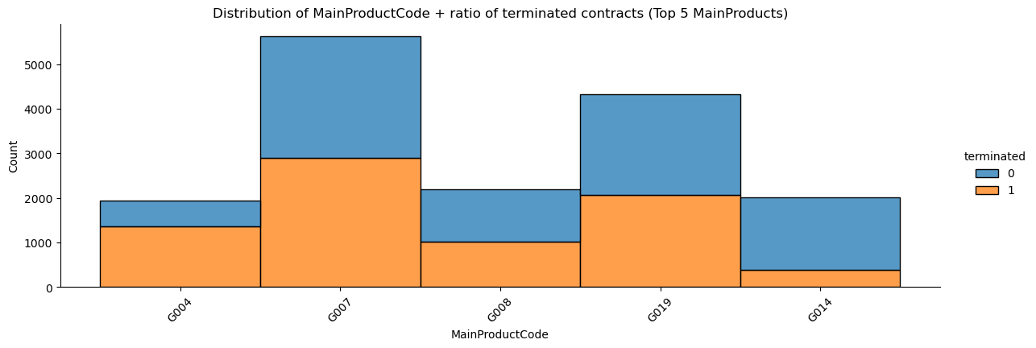
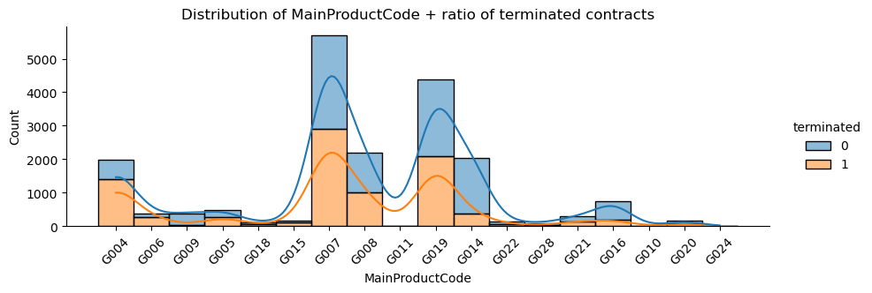
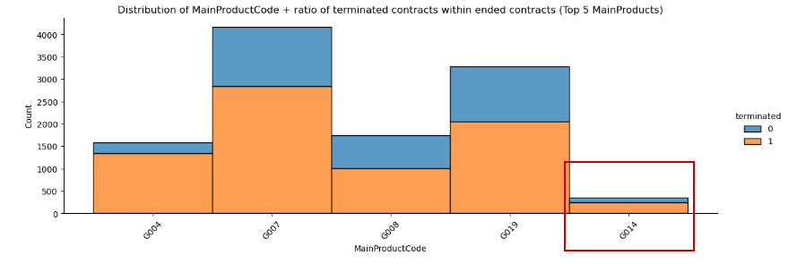
Churn Prediction – Target variable
Notes:
termination is not a rare thing. ~1/2 of all contracts are terminated → several reasons. E.g. different types of product:
G004: Business → terminated, e.g. when employee cancelled
G014: Infinity → lifelong → if ended, it’s terminated most of the times (overall 19% terminations vs. 70% within ended contracts)
effEnd is a major impact
→ Looking only at ended contracts → it’s even ~2/3 terminations

Slide 27
Churn Prediction – Alternative target
Notes:
Looking at reasons of termination:
Mostly unspecific: Not know, No longer needed, Non-Payment (Cancelled by company by end of next month → next month not paid → terminated)
Looking only at reasons that show dissatisfaction → imbalanced data

Slide 28
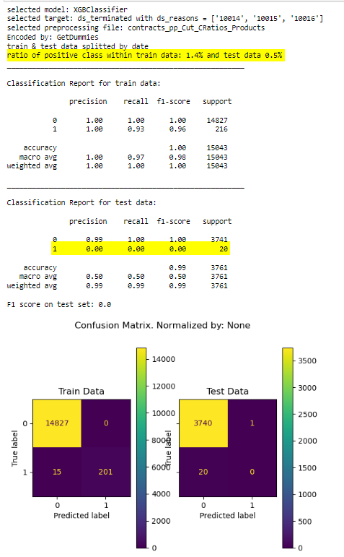
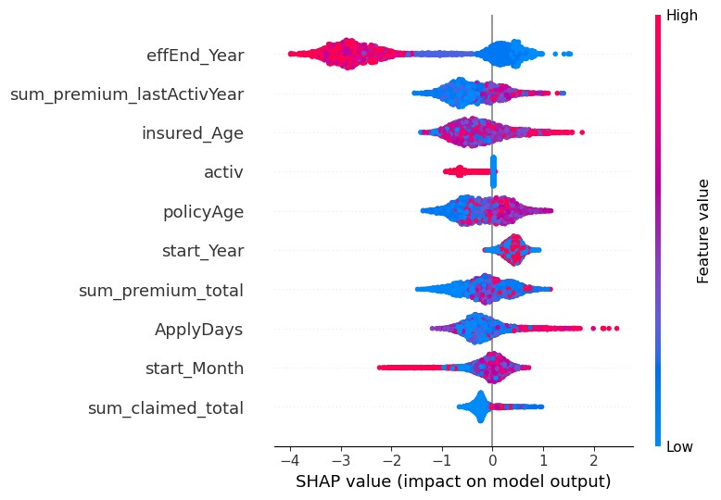
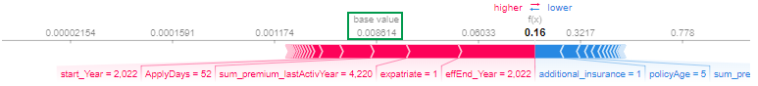
Churn Prediction – First results ds_terminated
Notes:
Left: First results on alternative target → F1_test = 0
Right: SHAP explanations: Base value < 0,01 → very low probability of class 1

Slide 29
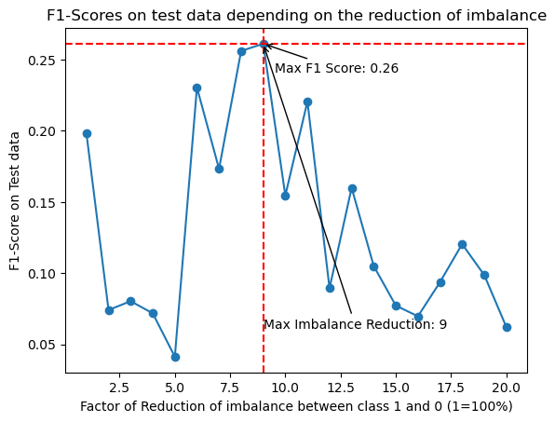
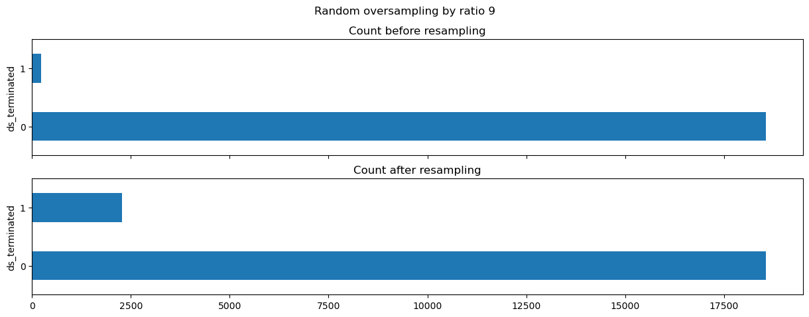
Churn Prediction – Resampling
Notes:
Resampling improved the score from 0 to ~0.3 on the test set
GridSearch von XGB further improved it to ~0.5
(But: test data got resampled to → higher chance as well for random choise)

Slide 30
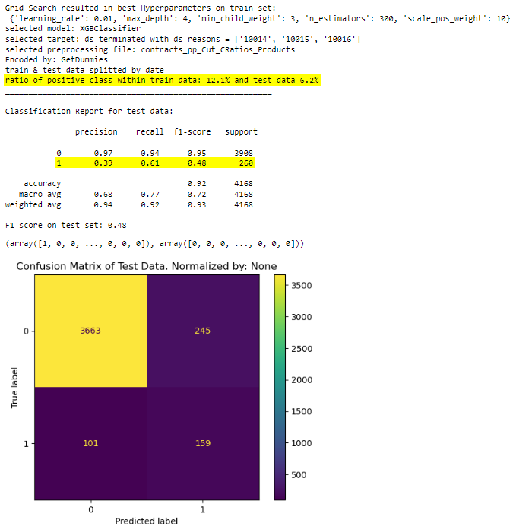
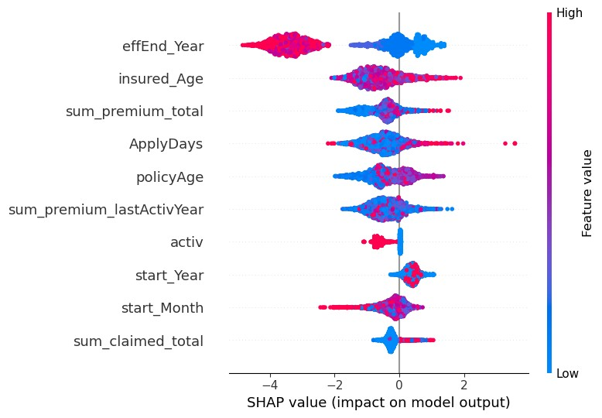

Churn Prediction – Results after resampling
Notes:
Left: Results after Resampling & GridSearch → F1_Test ~0.5
Right: New SHAP data → Higher base value & greater impact of feature values
(apparently greater termination probability created artificially)

Slide 31

Churn Prediction – Random Test data
Notes:
Left: Score was OK for Decision Tree on random train-/test-splitted data.
Right: New train-test/split by startDate

